Slide 1
Outcomes
Conservation Assessment Ranking Tool Outcomes
Provides leadership within NRCS the ability to model data and report the natural resource impacts and outcomes of conservation practices, systems, programs and initiatives. It will also facilitates the ability to identify conservation treatment needs and the ability to report outcomes for NRCS and USDA.
Measuring the success of conservation practice implementation.
Using soils data to help validate conservation practices.
Providing technical soil services using soil scientist to collect data for validation
Notes:
https://jneme910.github.io/CART/chapters/Outcomes

Slide 2
Future Soil Cart Enhancements
Develop Soil Property and Interpretation SQL Scripts to assist conservation planning for specific practices.
Develop soil interpretations (CART soil interpretation generator) to assist in special conservation signups by identifying opportunities for conservation. Examples:
Golden Wing Warblers can be found in alder (along swamps-edges). Soils data could be used to query certain locations and help identify customers (by locating the most productive sights for declining habitats).
Karner Blue Butterfly Habitat Identification.
feed exclusively on the leaves of wild lupine.
NRCS and partner staff wanted to identify likely lupine habitat to prioritize for protection under NRCS easements and related programs.
Add thematic maps by map unit and land unit.
Notes:
https://jneme910.github.io/CART/chapters/future

Slide 3
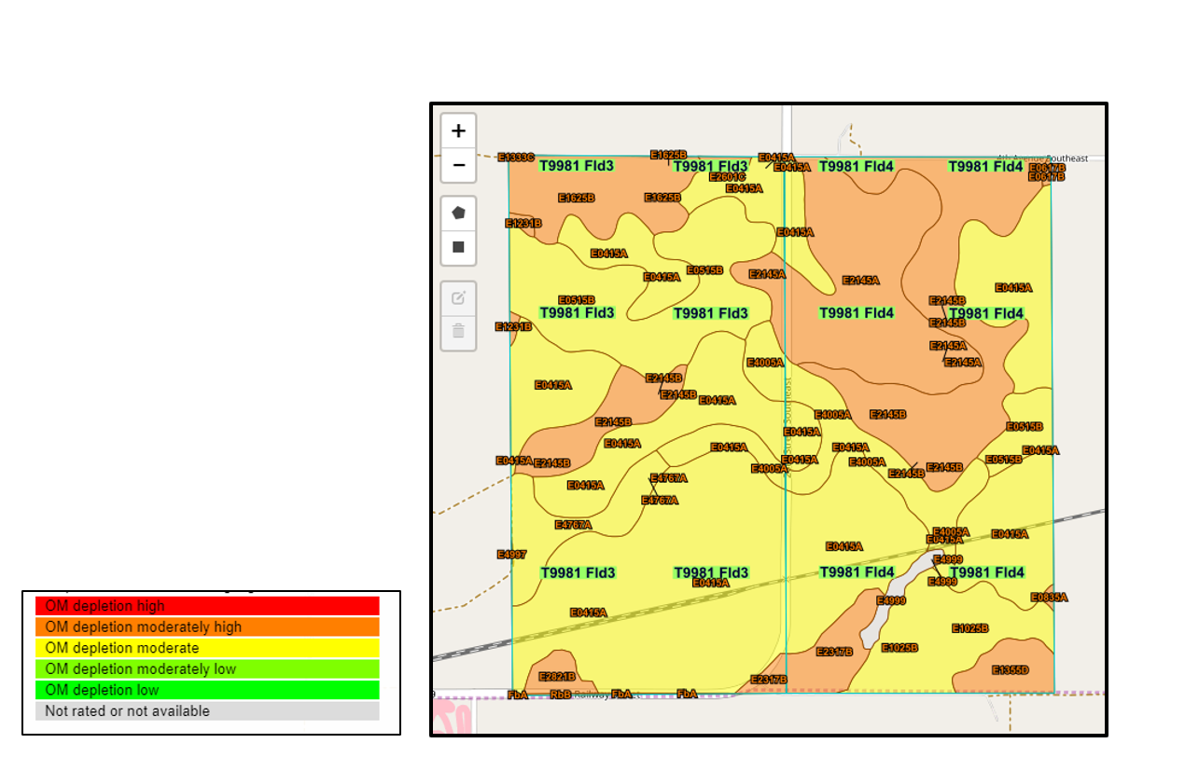
Example for Proposal #6: Thematic Soil Map
Organic Matter Depletion

Slide 4
Soil Quality Degradation
CART has six resource concerns related to Soil Quality Degradation and each will involve analysis of soil interpretation data from the Soil Data Access Query service. Soil maps and reports for these interpretations are also available from Web Soil Survey. Both applications are connecting to the same soils database.
The soils data used in CART can be found in four main sections.
Resource Assessment (Resource Concerns);
Soil Quality Degradation
Other
EP—Easement Program
EE—Environmental Evaluation
Outcome Results (Under Development)

Slide 5
Soil Data Access Requests by CART
The request for soils data begins once landunits have been selected.
The request is in the form of an SQL query and contains:
Landunit identifier
Bounding coordinates
CART will automatically bundle the request and send it the to Soil Data Access Query Service.
Map layers are processed in the background. and are not displayed.
Park County, Wyoming (245 acres)

Slide 6
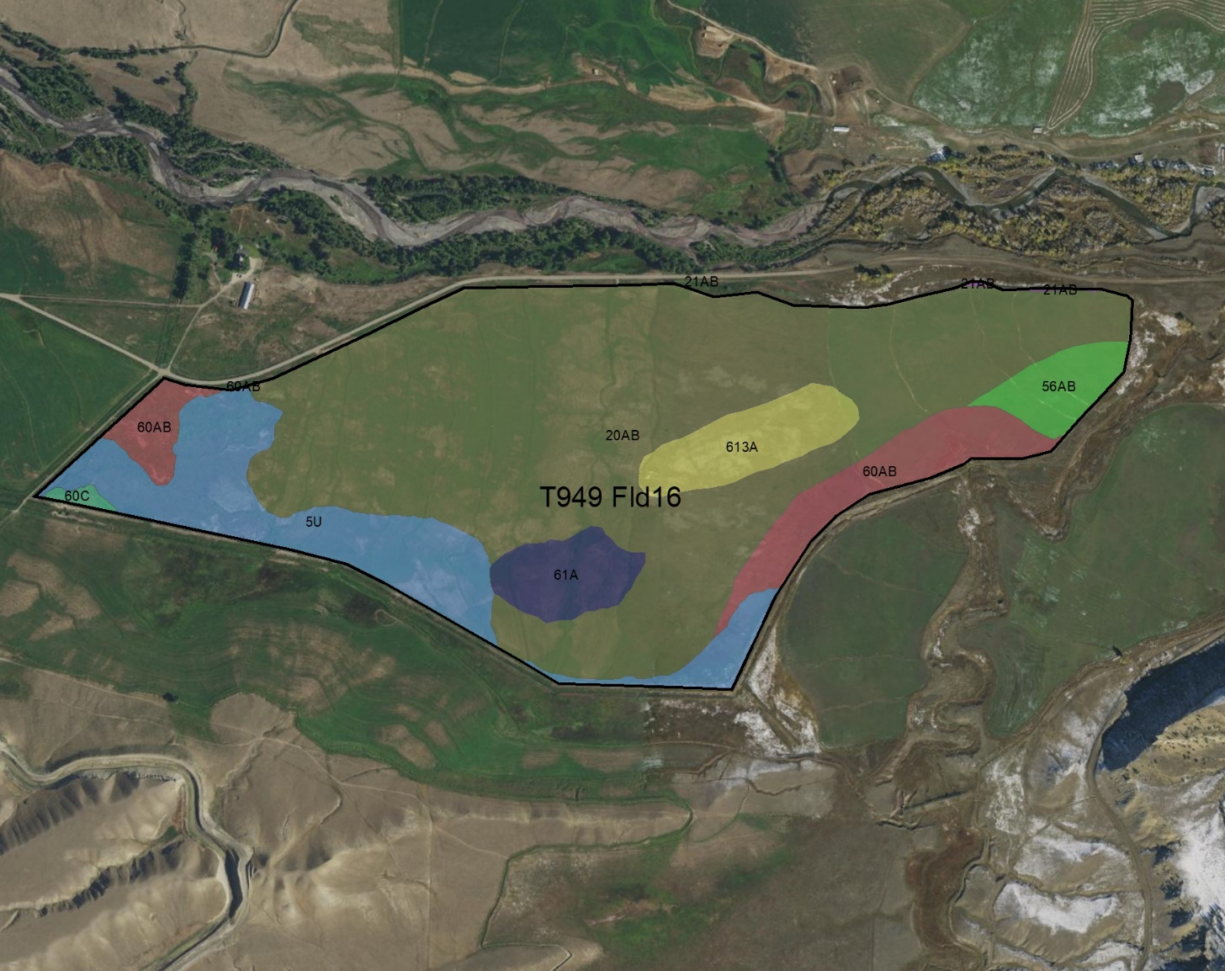
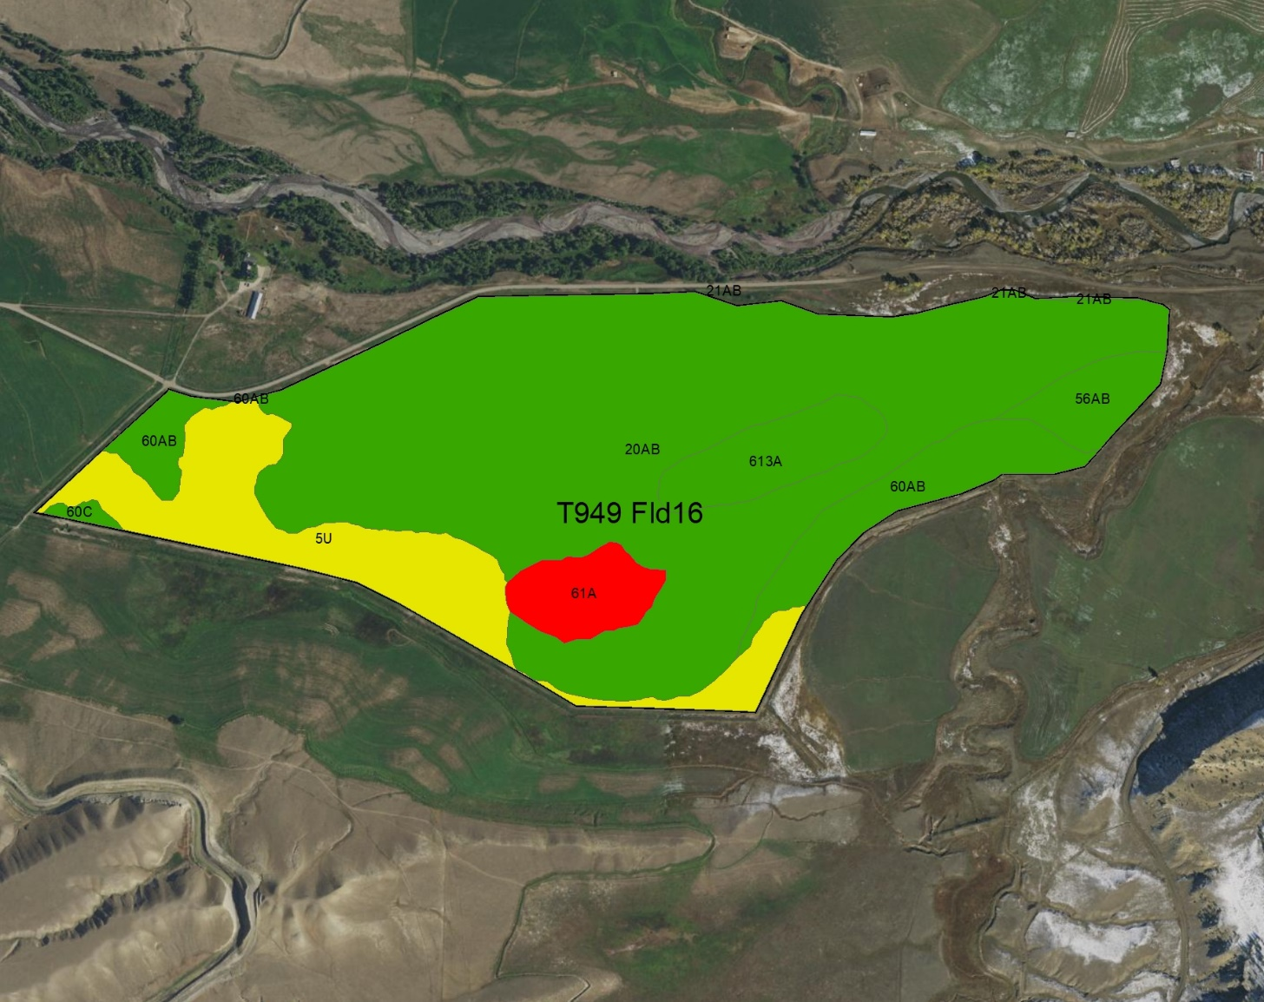
Map data is processed in the background
Basic Soil Map
Risk of Surface Salt Concentration
The map on the left shows 8 different soils within this landunit. The map on the right side illustrates risk of surface salinization. The red polygon indicates an area of high risk for surface salinization, yellow areas have a moderate risk and green areas are low risk.

Slide 7
Service Data
In the example below, the Query service returned statistics for the ‘Risk of Surface Salt Concentration’ within the landunit. The rating data shown in table below is then used to calculate the magnitude of each rating as both a landunit percentage and as landunit acres.
Landunit | Soil Interpretation Name | Soil Interpretation Rating | Rating Number | CART Rating | Rating Percent | Rating Acres | Land Unit Acres | Rolling Percent | Rolling Acres
T949 Fld16 | Surface Salt Concentration | High surface salinization risk or already saline | 1 | Surface Salt Concentration:1 | 3.9 | 9.54 | 244.78 | 3.9 | 9.54
T949 Fld16 | Surface Salt Concentration | Surface salinization risk | 2 | Surface Salt Concentration:2 | 15.2 | 37.20 | 244.78 | 19.1 | 46.74
T949 Fld16 | Surface Salt Concentration | Low surface salinization risk | 3 | Surface Salt Concentration:3 | 80.9 | 198.04 | 244.78 | 100.0 | 244.78
Areas with the highest risk were assigned a rating value of 1. Areas with a lower risk were assigned a higher rating value. These rating values are calculated at the component level. Component acres are estimated using the spatial map unit polygon acres and comppct_r.

Slide 8
Landunit Detailed Ratings
The query calculates the rolling sum values for rating_acres and rating percent for each resource concern and finds the single most limiting rating (per landunit) that comprises at least 10% by area or 10 acres.
Landunit | Soil Interpretation Name | Soil Interpretation Rating | Rating Number | CART Rating | Rating Percent | Rating Acres | Land Unit Acres | Rolling Percent | Rolling Acres
T949 Fld16 | Surface Salt Concentration | High surface salinization risk or already saline | 1 | Surface Salt Concentration:1 | 3.9 | 9.54 | 244.78 | 3.9 | 9.54
T949 Fld16 | Surface Salt Concentration | Surface salinization risk | 2 | Surface Salt Concentration:2 | 15.2 | 37.20 | 244.78 | 19.1 | 46.74
T949 Fld16 | Surface Salt Concentration | Low surface salinization risk | 3 | Surface Salt Concentration:3 | 80.9 | 198.04 | 244.78 | 100.0 | 244.78
In this example for ‘Surface salt concentration’, it is the second row that meets these criteria and will be provided to the CART application as the final landunit rating. It is important to understand that this type of functionality for calculating landunit ratings is not currently available from Web Soil Survey.

Slide 9
Final Landunit Ratings
The final Soil Data Access landunit ratings for each of the resource concerns will be returned to CART for awarding of points. The publication date of the soils data will also be returned to CART as metadata. This will ensure that any of the Soil Quality Degradation ratings can be tied back to a particular version of SSURGO soils data. This is the only information that CART will use in calculating points.
Landunit | Landunit Ratings | Soil Survey Publication Date
T949 Fld16 | Agricultural Organic Soil Subsidence:4 | WY629 2018-09-14 18:51:24
T949 Fld16 | Organic Matter Depletion:2 | WY629 2018-09-14 18:51:24
T949 Fld16 | Soil Susceptibility to Compaction:1 | WY629 2018-09-14 18:51:24
T949 Fld16 | Surface Salt Concentration:2 | WY629 2018-09-14 18:51:24

Slide 10
This domain table contains an ordered list of all possible rating values.
Line | CART Rating | Soil Interpretation Name | Soil Interpretation Rating Class | Rating Number
1 | Surface Salt Concentration:1 | Surface Salt Concentration | High surface salinization risk or already saline | 1
2 | Surface Salt Concentration:2 | Surface Salt Concentration | Surface salinization risk | 2
3 | Surface Salt Concentration:3 | Surface Salt Concentration | Low surface salinization risk | 3
4 | Surface Salt Concentration:4 | Surface Salt Concentration | Not rated | 4
5 | Soil Susceptibility to Compaction:1 | Soil Susceptibility to Compaction | High | 1
6 | Soil Susceptibility to Compaction:2 | Soil Susceptibility to Compaction | Medium | 2
7 | Soil Susceptibility to Compaction:3 | Soil Susceptibility to Compaction | Low | 3
8 | Soil Susceptibility to Compaction:4 | Soil Susceptibility to Compaction | Not rated | 4
9 | Organic Matter Depletion:1 | Organic Matter Depletion | OM depletion high | 1
10 | Organic Matter Depletion:2 | Organic Matter Depletion | OM depletion moderately high | 2
11 | Organic Matter Depletion:3 | Organic Matter Depletion | OM depletion moderate | 3
12 | Organic Matter Depletion:4 | Organic Matter Depletion | OM depletion moderately low | 4
13 | Organic Matter Depletion:5 | Organic Matter Depletion | OM depletion low | 5
14 | Organic Matter Depletion:6 | Organic Matter Depletion | Not rated | 6
15 | Agricultural Organic Soil Subsidence:1 | Agricultural Organic Soil Subsidence | Severe subsidence | 1
16 | Agricultural Organic Soil Subsidence:2 | Agricultural Organic Soil Subsidence | Moderate subsidence | 2
17 | Agricultural Organic Soil Subsidence:3 | Agricultural Organic Soil Subsidence | Low subsidence | 3
18 | Agricultural Organic Soil Subsidence:4 | Agricultural Organic Soil Subsidence | Mineral soil | 4
19 | Agricultural Organic Soil Subsidence:5 | Agricultural Organic Soil Subsidence | Not rated | 5

